Slide 1
Hotel Agency MSBI
Dakota Wells - Team Lead
Ayanes Arapioannou
Robert Palmer
Spencer Barck

Slide 2
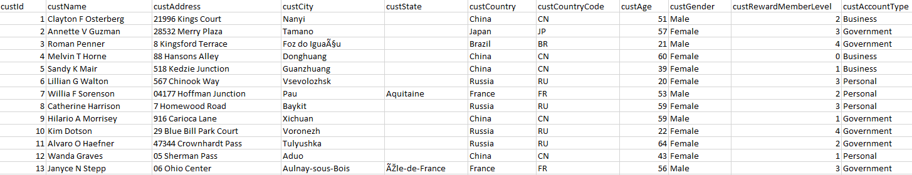
Original Data- Excel Spreadsheet

Slide 3
Business Grew, Transitioned into RDBMS
Preserved historical data in the new database
Normalized the database to reduce redundancy
Extracted and Transformed Excel data to load it into the database
Wrote stored procedures to quickly and easily enter new booking and customer information
Wrote views to quickly get a live view of the data

Slide 4
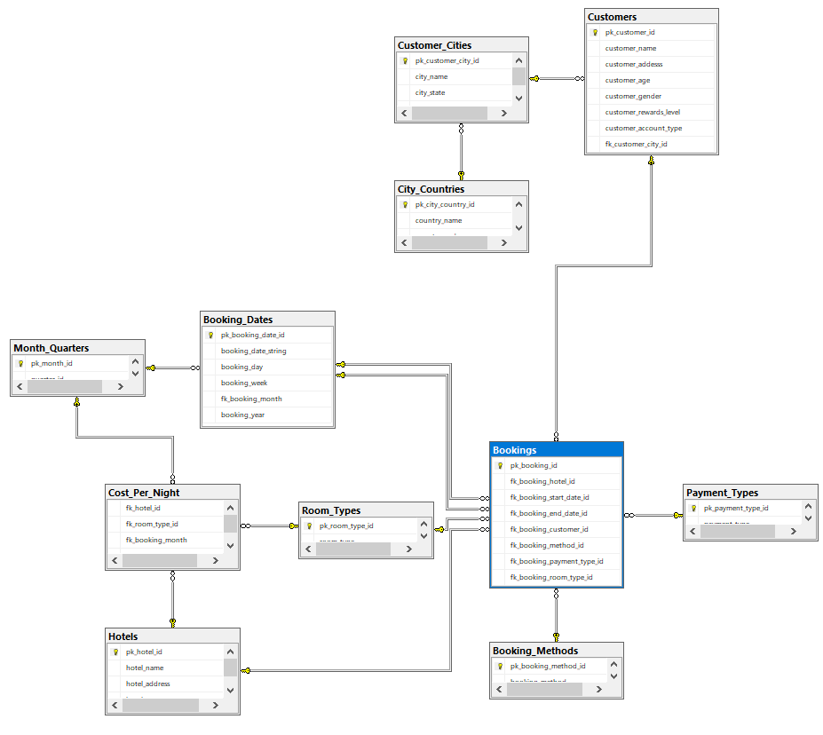
Designed the Relational Database

Slide 5
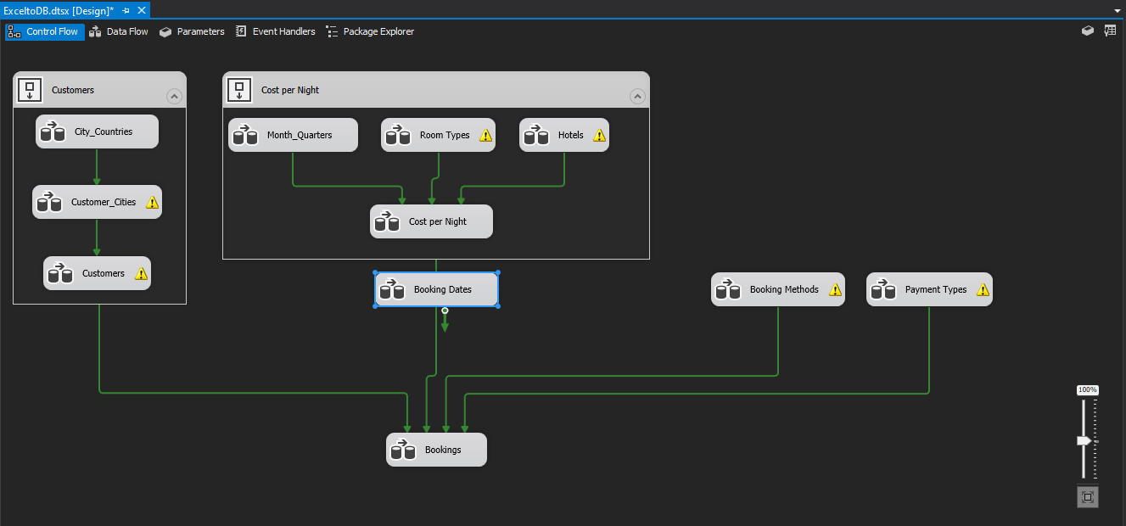
SSIS to Perform ETL Operations

Slide 6
Business Needs Faster Way of Accessing Historical Data
Normalized database is great for storage- but falls flat on performance
Denormalized the database
Created a Data Warehouse
Constructed Dim and Fact Tables
Used SSIS once again to perform ETL, transferred data from the database to data warehouse

Slide 7
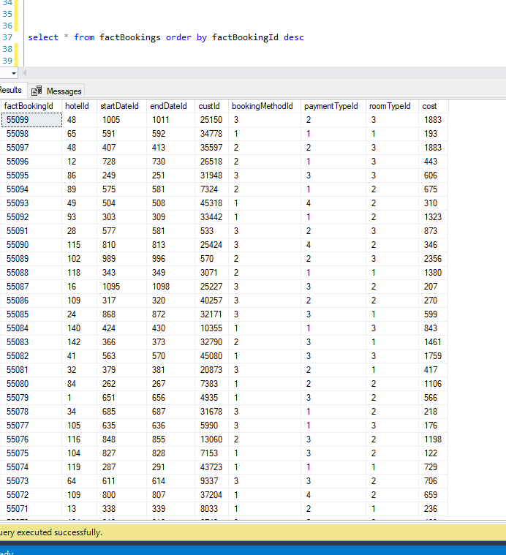
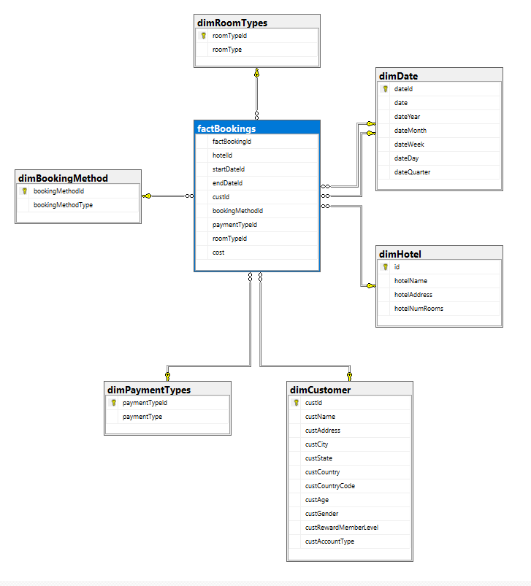
Data Warehouse
(insert screenshot of fact table)

Slide 8
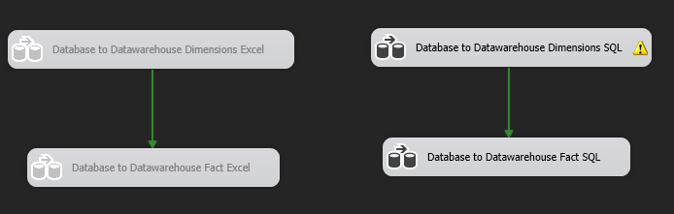
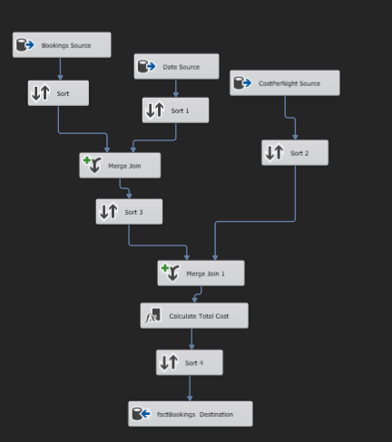
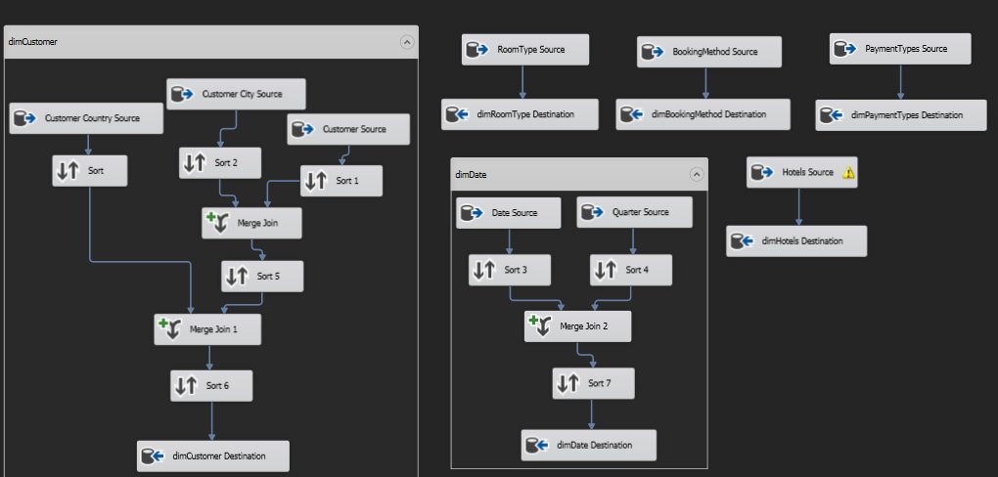
SSIS: DB to DW
(insert screenshot of db to dw ssis project)

Slide 9
Business Needs to Perform Data Analytics
Converted the data warehouse into an OLAP Cube
Deployed the cube to a Microsoft Analysis Server
Designed MDX queries to retrieve information from the cube

Slide 10
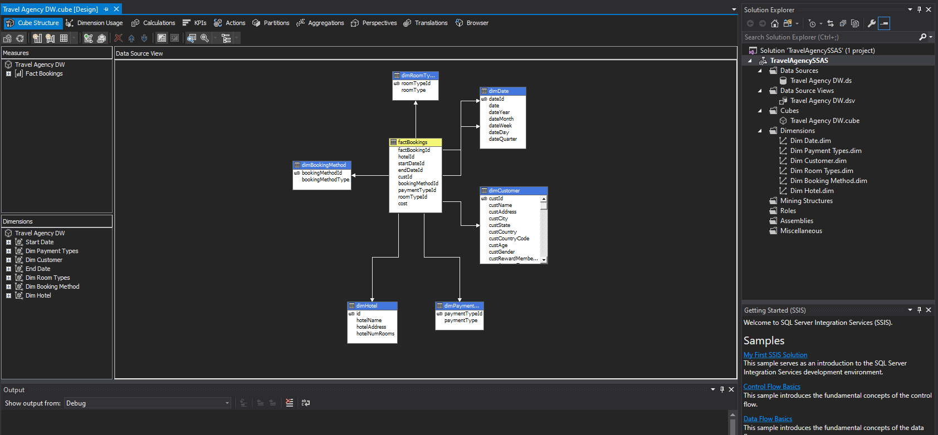
Cube Creation
(screenshot of SSDT analysis project)

Slide 11
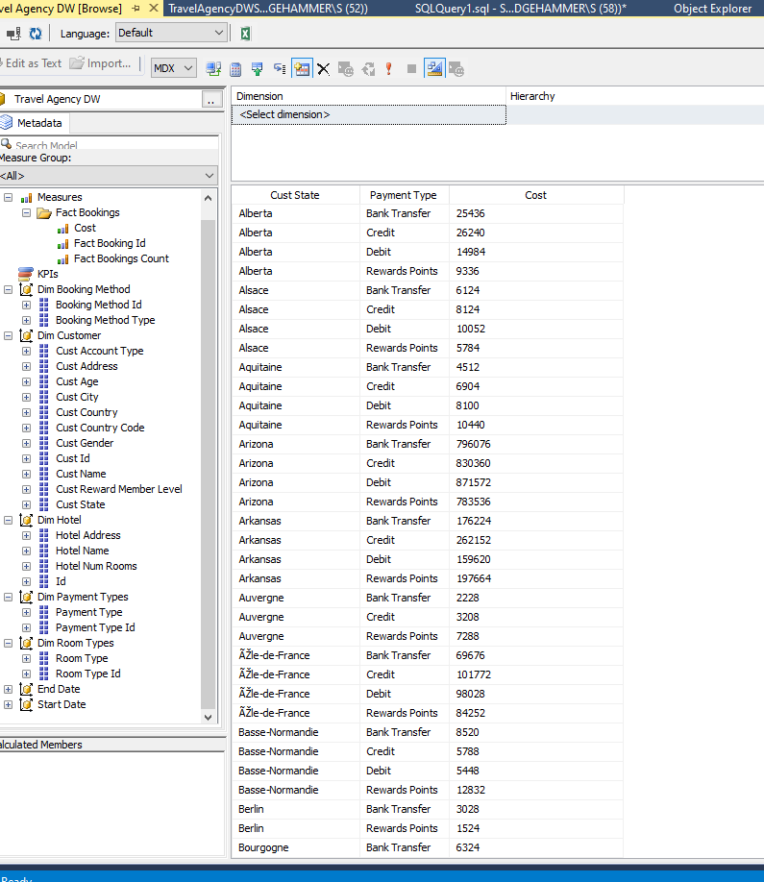
Analysis
SELECT NON EMPTY { [Measures].[Cost] } ON COLUMNS, NON EMPTY { ([Dim Customer].[Cust State].[Cust State].ALLMEMBERS * [Dim Payment Types].[Payment Type].[Payment Type].ALLMEMBERS ) } DIMENSION PROPERTIES MEMBER_CAPTION, MEMBER_UNIQUE_NAME ON ROWS FROM [Travel Agency DW] CELL PROPERTIES VALUE, BACK_COLOR, FORE_COLOR, FORMATTED_VALUE, FORMAT_STRING, FONT_NAME, FONT_SIZE, FONT_FLAGS
MDX Queries in Microsoft SQL Server Management Studio

Slide 12
Business wants analytics in easy to read and use reports
Designed reports that show information business owners and stakeholders would like to see
Utilized parameters, links, and maps for easy readability and navigation
Deployed to a report server so business can log in and access updated reports at any time

Slide 13
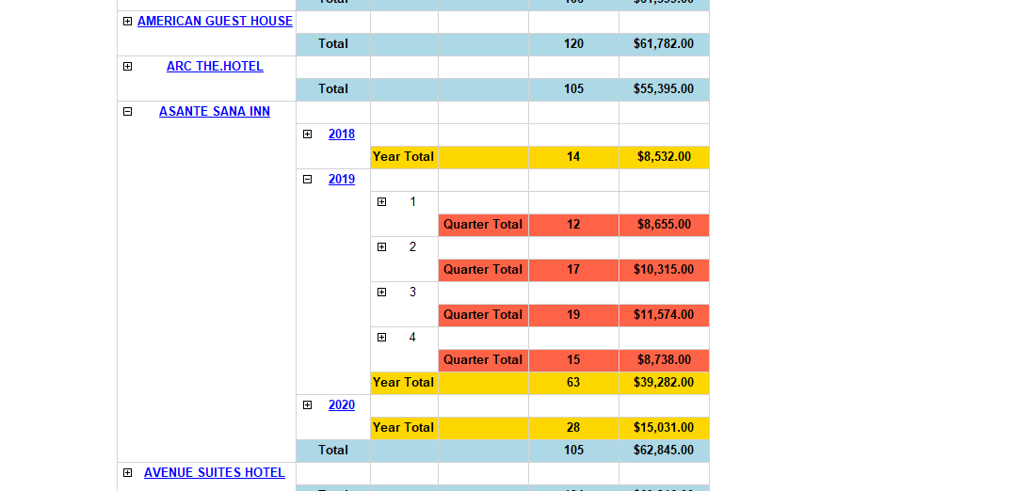
Drill Down Reports
(screenshot)

Slide 14
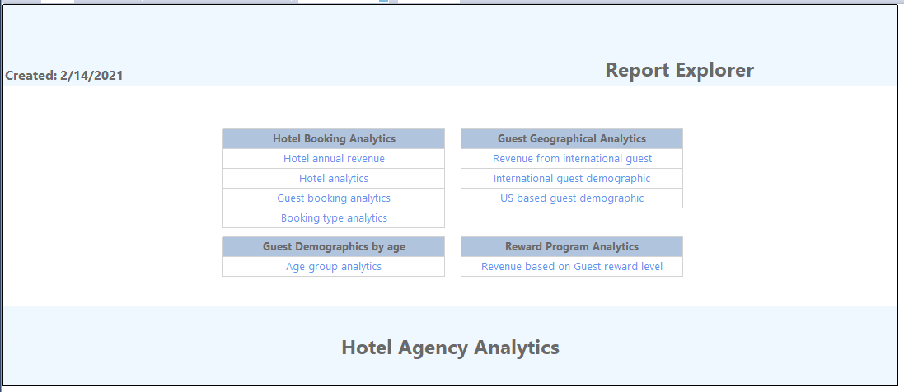
Linked reports
Created a master report that links you to all available reports

Slide 15
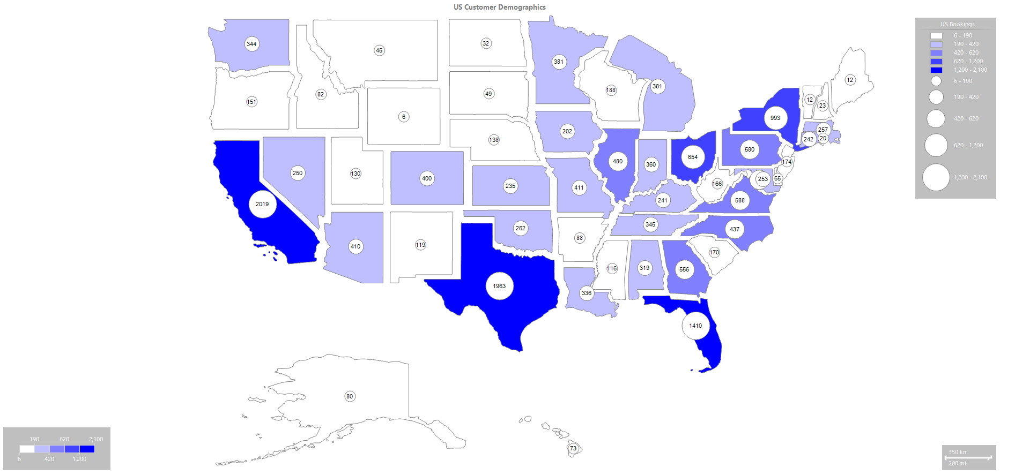
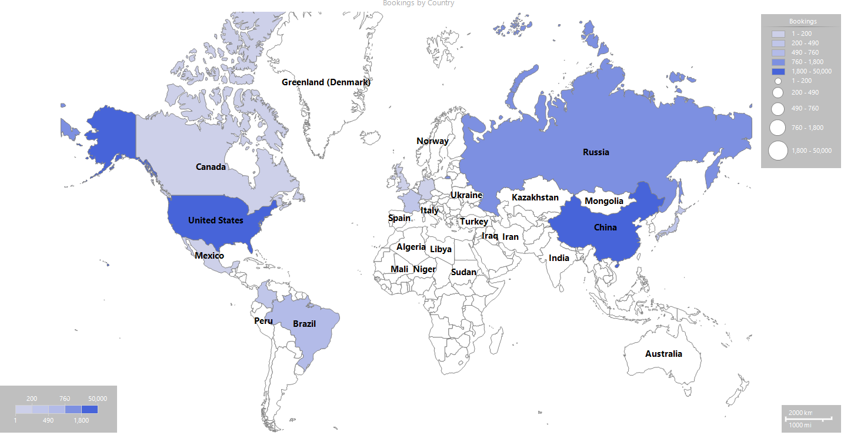
Reports showing Guest Analytics with maps
Leveraged maps to visually represent geographical data

Slide 16
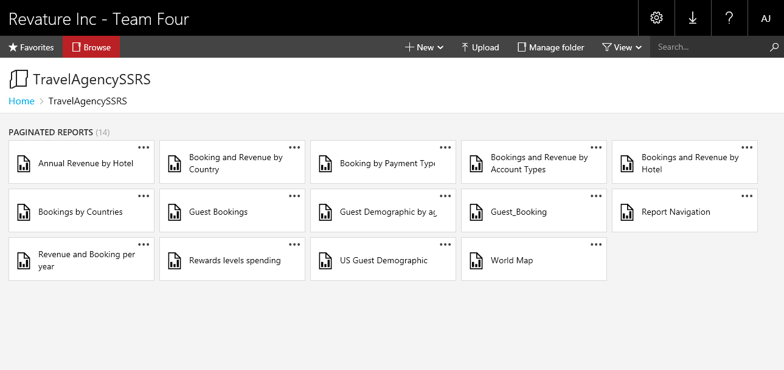
Report Server

Slide 17
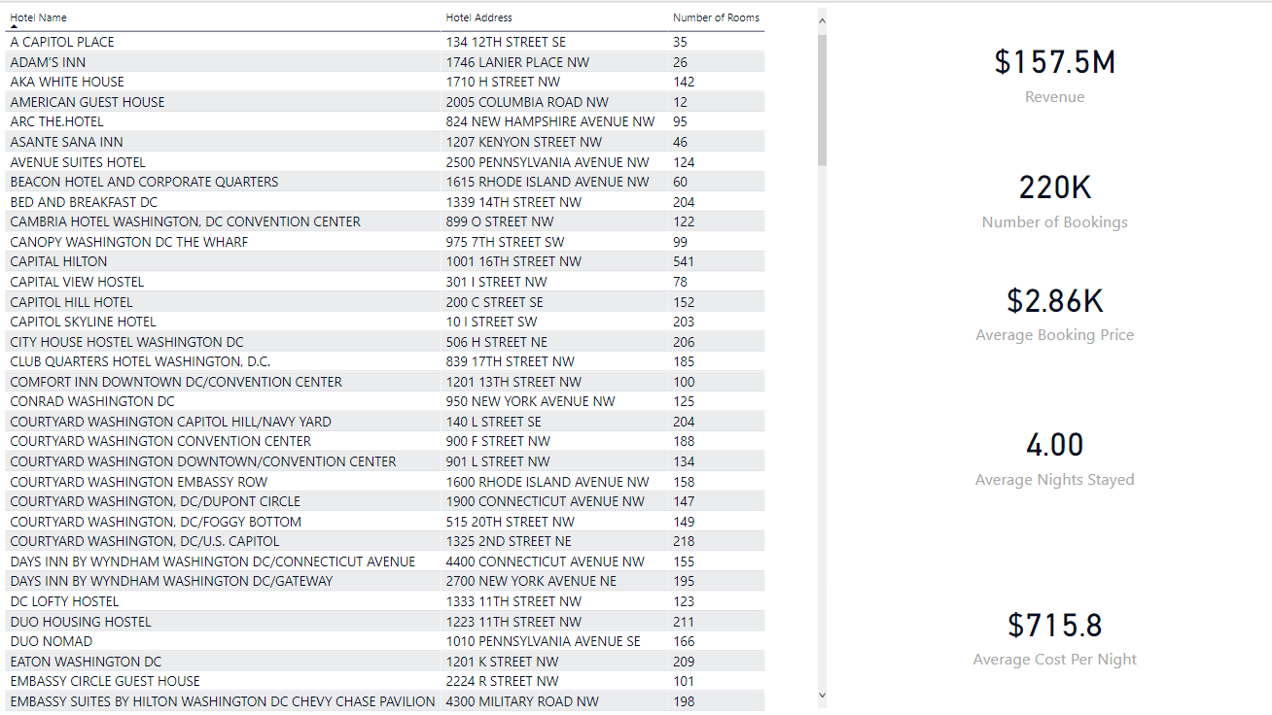
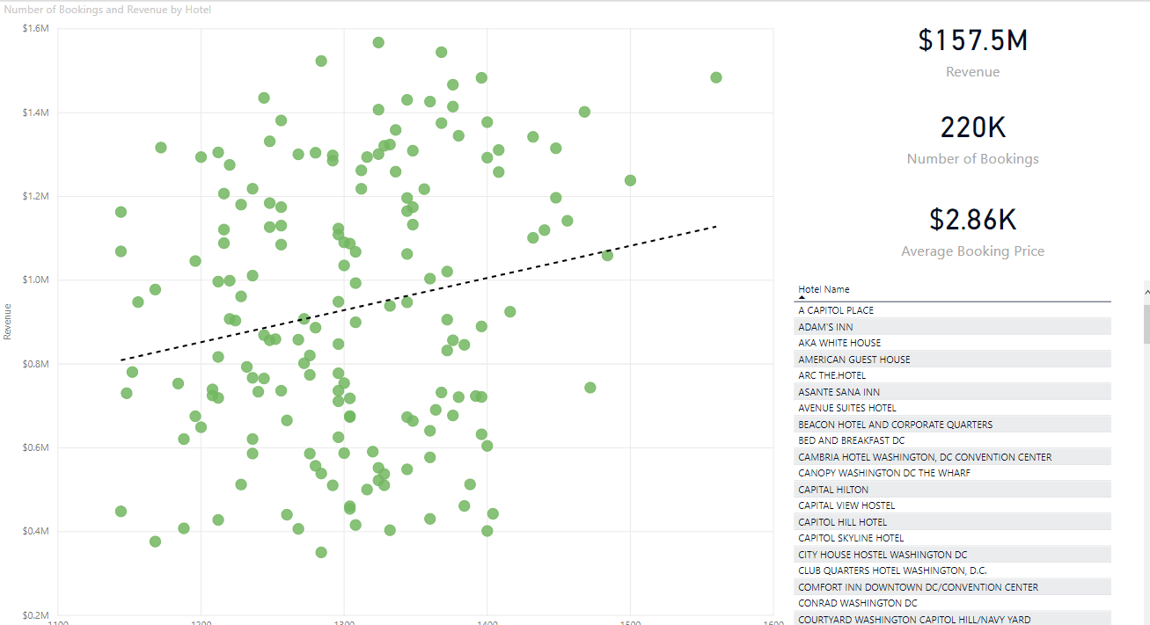
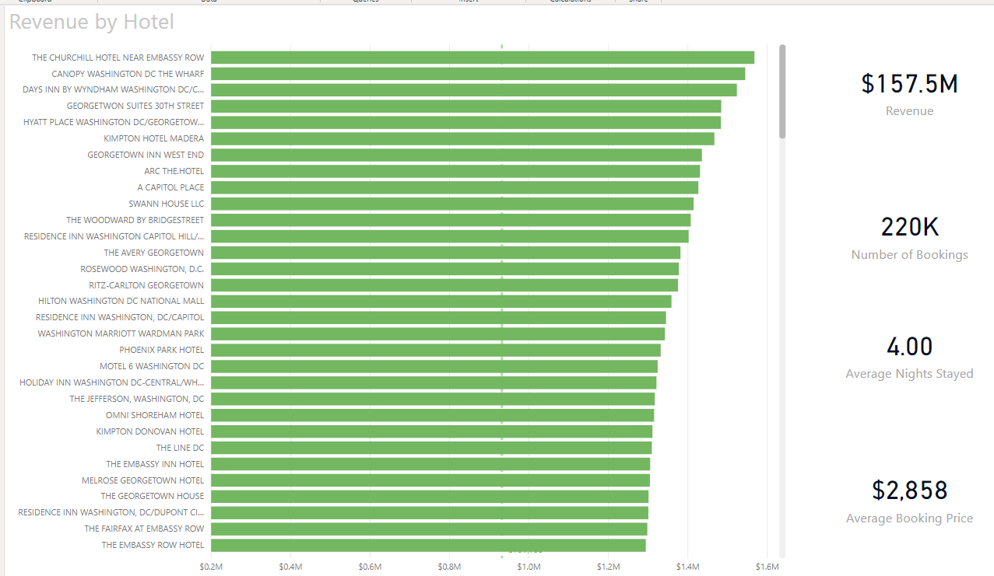
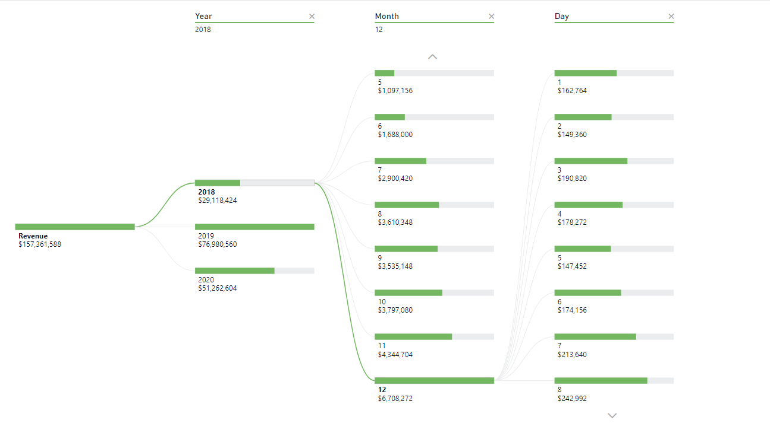
Power BI Reports

Slide 18
Future Plans
Host database on Azure
Schedules and subscriptions
Occupancy measure

